Slide 1
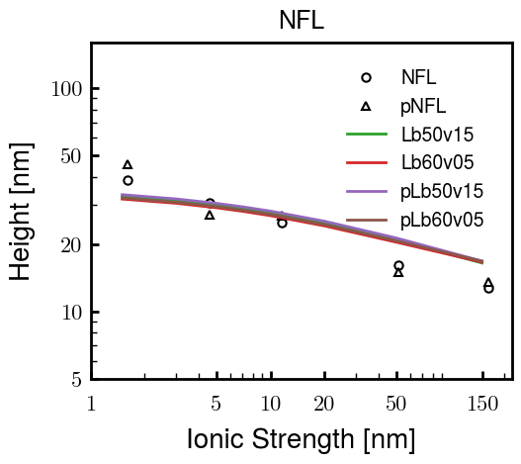
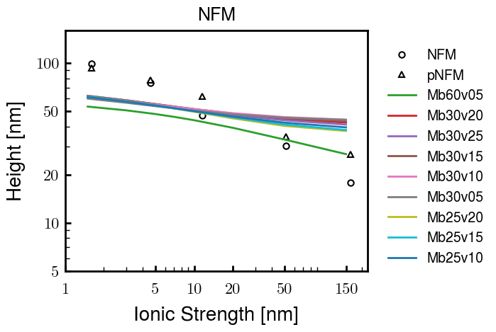
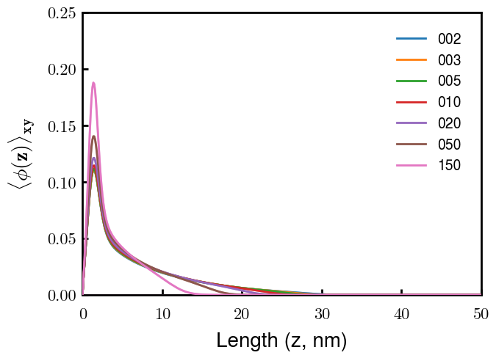
Looks good – choose later if needed. If consistent with others, scale total volumes by contour length for all

Slide 2
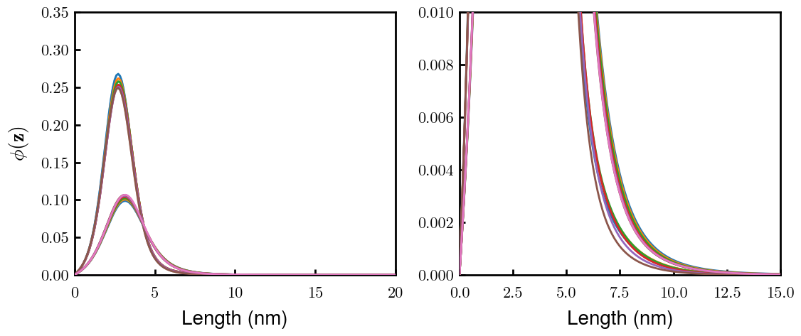
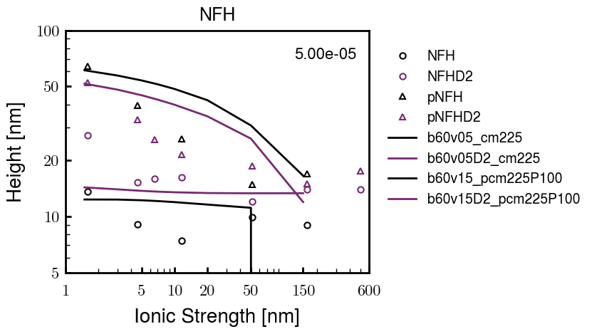
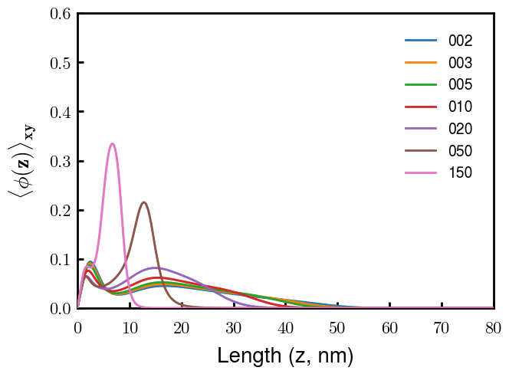
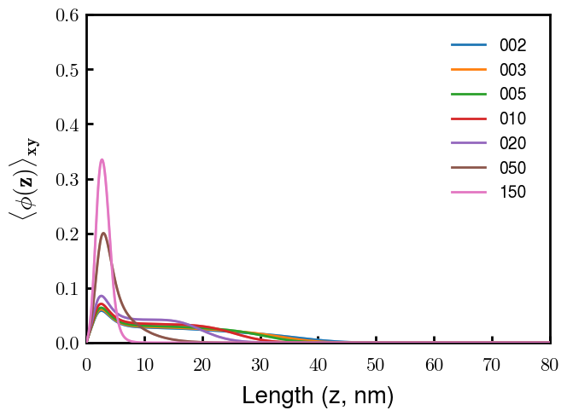
(p)NFH(D2)
NFH
NFHD2
pNFH
pNFHD2
(v = -1)
Points
v05 → v15 after phosphorylation
No condensed multilayer but worse fit

Slide 3




NFH (original); 31, 4
NFHD2; 40, 4
D2: delete 36-72
Rerun alg on D2
NFH (phos); 36, 4
NFHD2 (phos); 33, 4
Note: not currently doing this

Slide 4
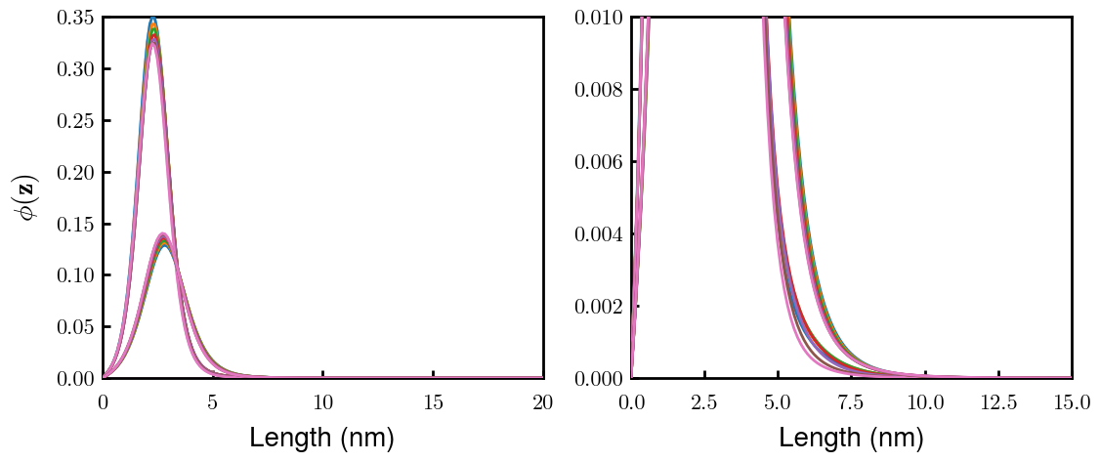
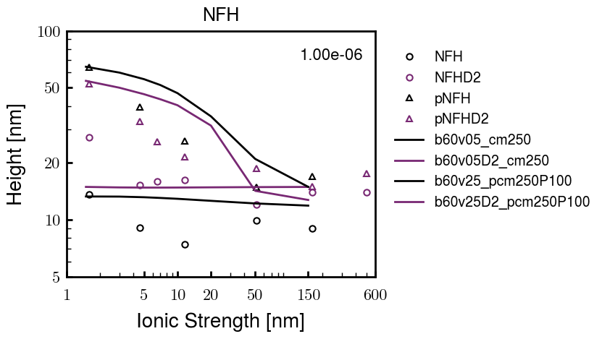
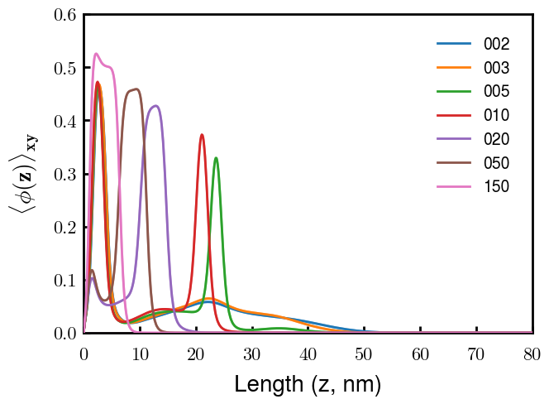
Best fit w/ consistent chi_max
NFH
NFHD2
pNFH
(v = -1)
Points
v05 → v25 after phosphorylation
Bilayer (trilayer for 5?) pNFH morphology

Slide 5
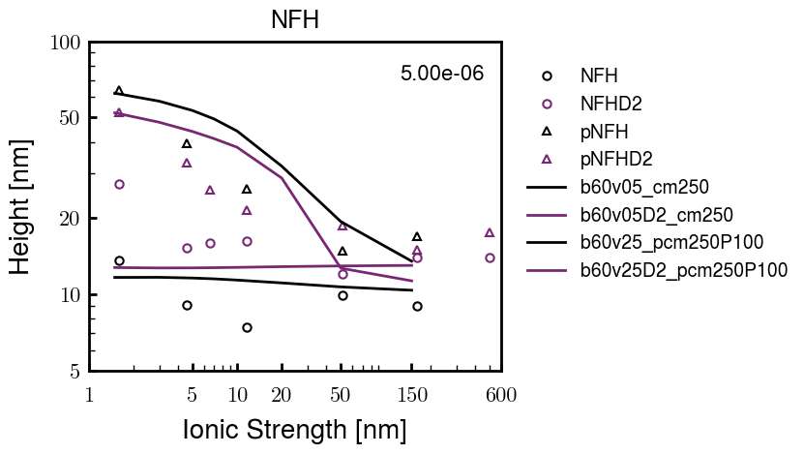
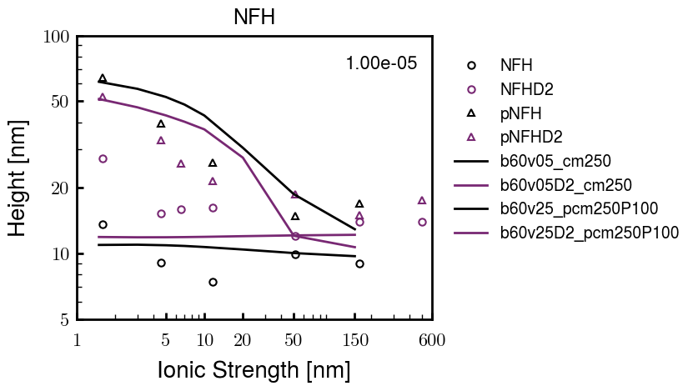
Same params as prev. w/ diff thresh

Slide 6
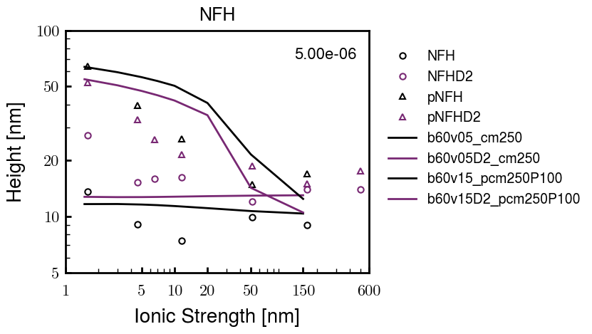
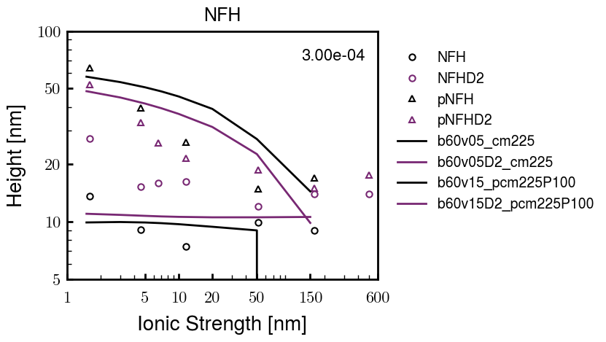
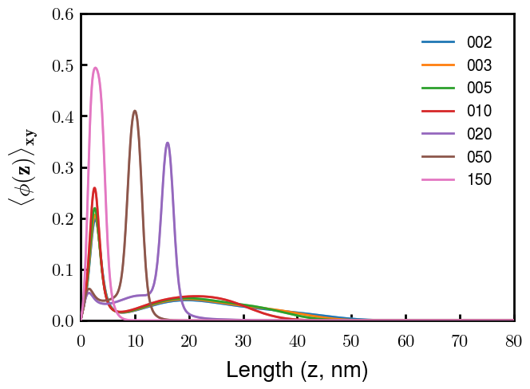
Find best without multilayer
pNFH
pNFH
(v = -1)
(v = -1)
Multilayer at 20

Slide 7
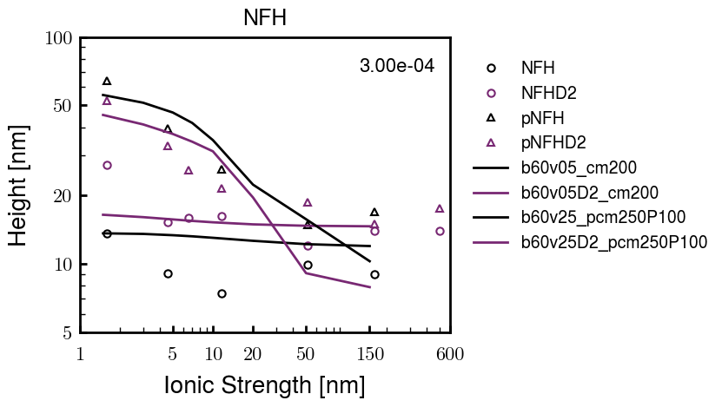
Best pNFH scaling fit (no regard to realistic)
pNFH
(v = -1)
Points
v05 → v25 after phosphorylation
cm200 → cm250 after phospho
Multilayer
Phospho < native

Slide 8






Native NFH

Slide 9







NFHD2

Slide 10




pNFH(D2)
4e-03

Slide 11





1e-06
4e-03
norm
4e-03
Try to bring pNFH down → {cmXX + PXX} only choice
norm
4e-03

Slide 12

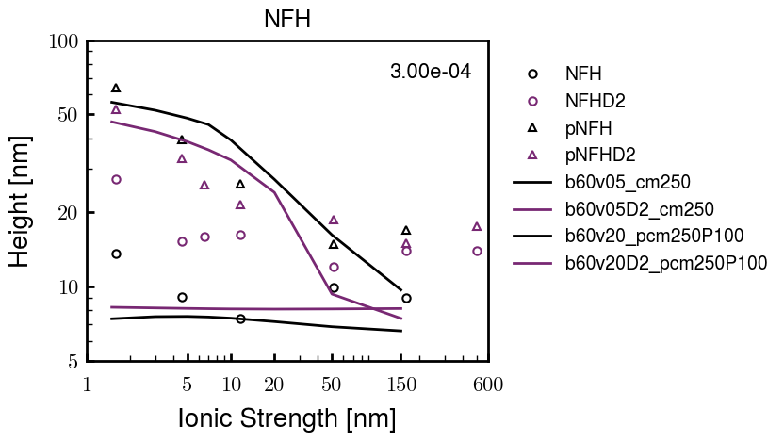


3e-04
3e-04
3e-04

Slide 13





Heights.params : b60v05 cm200
norm
1e-06
1e-05
1e-04
4e-03

Slide 14






Heights.params : b60v05 cm250
norm
ylog
norm
ylin
1e-06
1e-05
1e-04
5e-03

Slide 15




Heights.params: b60v10 cm{200, 225}
norm
1e-06
1e-05
1e-04
5e-03

Slide 16



Slide 17



 | Slope Bins 4 | Smear Count 25
Block number | Alpha w/ Henderson Hasselbalch | Chi Chi_max = 2.2
[0 50] | 0.040012 | 1.160000
[50 75] | -0.278451 | 0.720000
[75 125] | -0.519707 | 0.608000
[125 156] | -0.154453 | 0.529032

Slide 18


 | Slope Bins 4 | Smear Count 31
Block number | Alpha w/ Henderson Hasselbalch | Chi Chi_max = 2.2
[0 31] | 0.001103 | 0.922581
[31 62] | -0.386873 | 0.703226
[62 93] | -0.290146 | 0.967742
[93 496] | 0.037164 | 1.098759
[496 527] | -0.064533 | 0.819355
[527 620] | 0.010682 | 0.756989
[620 647] | -0.103326 | 0.696296

Slide 19






Previous
New

Slide 20





Slide 21


Response to stimuli given composition
Same data
Effect of composition given environment

Slide 22


NFL, pH 7.44, phos 1.5e (locs from LCMS)
Non-phos NFL
Block number | Alpha w/ Henderson Hasselbalch | Chi Chi_max = 3.2
[0 50] | 0.040012 | 1.540000
[50 75] | -0.278451 | 0.960000
[75 125] | -0.519707 | 0.868000
[125 156] | -0.154453 | 0.690323
 | Slope Bins 4 | Smear Count 25
Block number | Alpha w/ Henderson Hasselbalch | Chi Chi_max = 3.2
[0 50] | -0.019988 | 1.540000
[50 75] | -0.278451 | 0.960000
[75 125] | -0.519707 | 0.868000
[125 156] | -0.154453 | 0.690323

Slide 23


NFM, pH 7.44, phos 1.5e (locs from LCMS)
 | Slope Bins 4 | Smear Count 32
Block number | Alpha w/ Henderson Hasselbalch | Chi Chi_max = 3.0
[0 32] | 0.079143 | 1.275000
[32 64] | -0.186340 | 1.125000
[64 96] | -0.327964 | 1.181250
[96 160] | -0.460694 | 0.787500
[160 224] | -0.124999 | 1.115625
[224 288] | -0.023510 | 0.956250
[288 352] | -0.242085 | 1.003125
[352 384] | -0.031302 | 1.125000
[384 416] | -0.123860 | 1.050000
[416 438] | 0.046945 | 1.281818

Slide 24





Bin 3 NFM, pH 7.44, phos 1.5e (locs from LCMS)

Slide 25




Bin 5 NFM, pH 7.44, phos 1.5e (locs from LCMS)

Slide 26



Phos 2 NFM, pH 7.44, phos 2.0e (locs from LCMS)

Slide 27



Chi 2.5 NFM, pH 7.44, phos 2.0e (locs from LCMS)

Slide 28



NFM, pH 7.44, non-phos

Slide 29


NFH, pH 7.44, phos 1.5e (locs from LCMS)
 | Slope Bins 4 | Smear Count 36
Block number | Alpha w/ Henderson Hasselbalch | Chi Chi_max = 3.2 | Chi Chi_max = 3.0
[0 36] | 0.000945 | 1.266667 | 1.20000
[36 72] | -0.527455 | 0.900000 | 0.85000
[72 324] | -0.208376 | 1.729365 | 1.628571
[324 396] | -0.111195 | 1.416667 | 1.333333
[396 432] | -0.152824 | 1.344444 | 1.266667
[432 647] | -0.033955 | 1.077209 | 1.015814

Slide 30




Phos block dashed
Phos block dashed

Slide 31



Best are b3.0 v2.0 and b3.0 v3.0, but max H not high enough
Possible solutions:
Lower chi_max
Change aa_disc to have more charge
Force spectra?
Better for low salt, but high salt will melt brushes together

Slide 32



M1
pMx5

Slide 33



b3.00; v1, 2
b4.00; v2, 2.5, 3, 5, 10
b5.00; v3, 10, 15, 40
53 Nk
39 Nk
32 Nk

Slide 34
Binary results

Slide 35



Matrix Approach
Updated 04/04/2023

Slide 36














H Vol decrease (by v)
H Vol decrease (by b)
Desired “linearity” by tuning /thresh/ based on polymer density of expelled NFL
L Vol decrease (by b)
Comes at severe cost of overall height. Have to minimize outer concentration to approach pure thresh of 1e-06

Slide 37














H Vol decrease (by v)
H Vol decrease (by b)
Chimax 3.5
Desired “linearity” by tuning /thresh/ based on polymer density of expelled NFL
L Vol decrease (by b)
Comes at severe cost of overall height. Have to minimize outer concentration to approach pure thresh of 1e-06

Slide 38








F (3.5)
Chimax 3.5
Chimax 3.0
Scaled by 1.5
Scaled by 1.6
Scaled by 1.6
Scaled by 1.5
Scaled by 1.5
Scaled by 1.5
Scaled by 1.8
Scaled by 1.8

Slide 39
















Last test: same stiffness factor (b^3/v0) but with varying total volume

Slide 40












H Vol decrease (by v)
H Vol decrease (by b)
a2C_30
a2D_30
a2E_30
Rerun for Cs
b1C_30
b1D_30
b1E_30
L Vol decrease (by b)
a1C_30
a1D_30
a1E_30
g1C_30
g1D_30
g1E_30
Rerun for Cs

Slide 41












H Vol decrease (by v)
H Vol decrease (by b)
a2C
a2D
a2E
b1C
b1D
b1E
Block 4 (NFL end)
L Vol decrease (by b)
a1C
a1D
a1E
g1C
g1D
g1E

Slide 42









H Vol decrease (by v)
Chimax 3.5
H Vol decrease (by b)
a2C_30
a2D_30
a2E_30
b1C_30
b1D_30
b1E_30
L Vol decrease (by b)
a1C_30
a1D_30
a1E_30
g1C_30
g1D_30
g1E_30

Slide 43







For i as L and H:
Pure height profiles
Mixed height profiles
Current L library
Current H library
Skip; marginal increase in vol prob not enough
Move onto chi3.0; larger NFL vol library

Slide 44





NFL
All plotting wrong L pure; look only at purp
NFH
H volume too low to neutralize L (v = 31 nm3/c)

Slide 45







H volume v = 60 nm3/c

Slide 46







H volume too low to neutralize L

Slide 47










NFH, V = 70
L30

Slide 48





NFH & NFL v = 0.15
a2D
b1D
g1D

Slide 49





Based on NFH b5v15c3, apply VL = VH
NFL and NFH are from same amino acids but diff chain lengths. Should VL = VH?
L30 / H70
L80 / H20
L30 / H70
L80 / H20

Slide 50






L30 / H70
L80 / H20
L30 / H70
L80 / H20

Slide 51
L Fitting

Slide 52


VL = VH

Slide 53







Try b change, v same as H (0.15)
Phi unrealistic (?)
Phi unrealistic
Phi very unrealistic
Phi very unrealistic

Slide 54






Try similar params to H
5.6
11.2
16.8
28
56
7.5
11.25
18.75

Slide 55







Try similar params to H, b0.36
7.8
15.6
23.4
31.2
Unrealistic vol
Not very sensitive to v; not high enough to intersect neighboring chains (function of b and sigma)

Slide 56


Continuation from prev params

Slide 57







v2.7 and some fine
b1.50 v2.7 c3.2
b1.75 v2.7 c3.2
b1.75 v2.5 c3.2
b1.75 v2.5 c3.0
b2.0 v2.7 c3.2
b2.25 v2.7 c3.2
b2.50 v2.7 c3.2
Phi too small to decrease v0

Slide 58










b2.0 v10.0 c3.0
b2.0 v8.0 c3.0
b2.0 v6.0 c3.0
b2.0 v4.0 c3.0
b2.0 v2.0 c3.0
Phi limit
b1.8 v10.0 c3.0
b1.8 v8.0 c3.0
b1.8 v6.0 c3.0
b1.8 v3.0 c3.0
b1.8 v2.0 c3.0
Phi limit

Slide 59





b1.6 v10.0 c3.0
b1.6 v8.0 c3.0
b1.6 v6.0 c3.0
b1.6 v2.0 c3.0
b1.6 v1.5 c3.0
Phi limit

Slide 60









b2.0 v2.7 c3.2
b3.0 v3.5 c3.5
b3.0 v7.0 c3.5
b3.0 v7.0 c3.0
Phi too small
Phi too small to decrease v0
b4.0 v12.0 c3.0
b5.0 v20.0 c3.0
b5.0 v20.0 c4.0
b5.0 v5.0 c3.0
b5.0 v10.0 c3.0
Phi too small to decrease v0

Slide 61





v20
b5.0 v20.0 c3.0
b4.5 v20.0 c3.0
b4.0 v20.0 c3.0
b3.5 v20.0 c3.0
v10
b5.0 v10.0 c3.0
b4.0 v10.0 c3.0
b3.0 v10.0 c3.0
b2.0 v10.0 c3.0

Slide 62




b2.00 v2.70 c3.20
b2.00 v2.75 c3.20

Slide 63
NFH fitting (from NFL best fit)

Slide 64








b1.00, v0.50, c3.2
b2.00, v4.00, c3.2, th2.5e-02
b1.00, v2.00, c3.2
b1.00, v1.00, c3.2

Slide 65
Mixture

Slide 66



Slide 67


b = 0.75

Slide 68





Slide 69
b = 1.0

Slide 70





Slide 71
b = 1.25

Slide 72




Chi 2.6
Bad vol frac

Slide 73








b25v0
b25v1
b25v2
b25v3

Slide 74




Chi 2.8
Bad vol frac

Slide 75





Slide 76
b = 1.50

Slide 77






Chi 2.8
Bad vol frac

Slide 78





Slide 79

b = 2.00
v4 = 0.25*b^3

Slide 80


Bad vol frac

Slide 81



Slide 82
Fine tune

Slide 83



b1.25, v1.95, c3.0
b1.50, v3.38, c3.0
b2.00, v4.00, c3.0
Norm seems to capture kinked behavior

Slide 84




Slide 85



b1.25, v1.95, c3.2
b1.50, v3.38, c3.2
b2.00, v4.00, c3.2

Slide 86




Slide 87


b1.25
b1.50
b2.00
c2.8
c3.0
c3.2

